Slide 1

Because learning changes everything.
®
Chapter 06
International Trade
Theory
INTERNATIONAL
BUSINESS
Competing in the Global Marketplace
2025 Release
Charles W.L. Hill
© McGraw Hill LLC. All rights reserved. No reproduction or distribution without the prior written consent of McGraw Hill LLC.

Slide 2
Learning Objectives
6-1
Understand why nations trade with each other.
6-2
Summarize the different theories explaining trade flows
between nations.
6-3
Recognize why many economists believe that
unrestricted free trade between nations will raise the
economic welfare of countries that participate in a free
trade system.
6-4
Explain the arguments of those who maintain that
government can play a proactive role in promoting
national competitive advantage in certain industries.
6-5
Understand the important implications that international
trade theory holds for management practice.
© McGraw Hill LLC
2

Slide 3
Introduction
Cross-Border Trade
•
Dramatic growth over the past 70 years in the amount of
international trade.
•
Recent acceleration of value in traded services.
•
Gains from trade: countries specialize in the production
(and export) of goods and services that they produce most
efficiently, while importing goods and services that they
cannot produce so efficiently from other nations.
•
Shift in policy away from free trade toward managed trade.
© McGraw Hill LLC
3

Slide 4
An Overview of Trade Theory
1
Free Trade
Government does not attempt to influence through quotas or
duties what its citizens can buy from another country or what
they can produce and sell to another country.
•
Adam Smith’s theory of absolute advantage.
•
David Ricardo’s theory of comparative advantage.
•
Heckscher–Ohlin theory.
© McGraw Hill LLC
4

Slide 5
An Overview of Trade Theory
2
The Gains from Trade
Trade theories explain why international trade is beneficial
even for products a country can produce itself.
•
Allows specialization.
Limits on imports are often in the interests of domestic
producers but not domestic consumers.
© McGraw Hill LLC
5

Slide 6
An Overview of Trade Theory
3
The Pattern of International Trade
Much of the observed pattern of international trade is more
difficult to explain.
•
Ricardo’s theory of comparative advantage focuses on
differences in productivity.
•
Heckscher–Ohlin theory focuses on factors of production.
•
Vernon’s product life-cycle theory focuses on production
location changes as products become more widely
accepted internationally.
•
Krugman’s new trade theory focuses on first-mover
advantages.
© McGraw Hill LLC
6

Slide 7

Competitive Advantage
Kristi Blokhin/Shutterstock
A Rolex Group logo sits on display above a luxury wristwatch store in Vienna, Austria.
© McGraw Hill LLC
7

Slide 8
An Overview of Trade Theory
4
Trade Theory and Government Policy
•
Mercantilism advocates government involvement in
promoting exports and limiting imports.
•
Smith, Ricardo, and Heckscher–Ohlin call for unrestricted
free trade.
•
New trade theory and Porter’s national competitive
advantage theory justify limited government intervention
for certain export-oriented industries.
© McGraw Hill LLC
8

Slide 9
Mercantilism
Mercantilism
Emerged in England in the mid sixteenth century.
•
Gold and silver are the mainstays of national wealth.
It is in a country’s best interest to maintain a trade surplus—
to export more than it imports.
•
Advocates government intervention to achieve a surplus in
the balance of trade.
Flaw is that it views trade as a zero-sum game:
•
A gain by one country results in a loss by another.
© McGraw Hill LLC
9

Slide 10
Absolute Advantage
Adam Smith (17
76),
The Wealth of Nations
Attacked the mercantilist assumption of zero-sum game.
Promoted absolute advantage:
•
Country has an absolute advantage in producing a product
when it is more efficient than any other country at
producing it.
•
Countries should specialize in the production of goods for
which they have an absolute advantage and then trade
these goods for those produced by other countries.
•
Both countries benefit by engaging and trading.
© McGraw Hill LLC
10

Slide 11
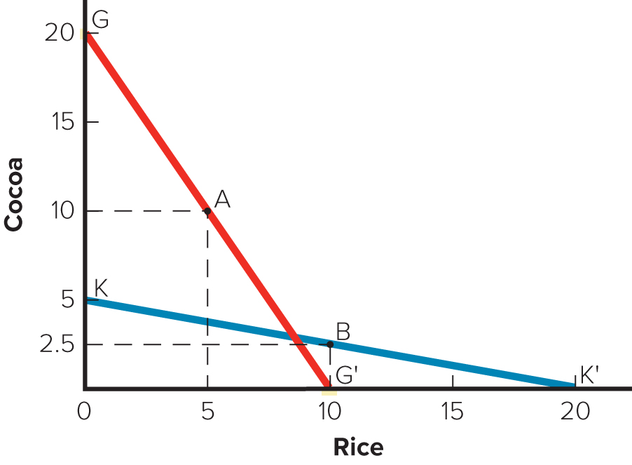
Figure 6.1 The Theory of Absolute Advantage
© McGraw Hill LLC
11

Slide 12
Comparative Advantage
1
David Ricardo (18 17)
Principles of Political Economy
Promoted comparative advantage:
•
A country should specialize in the production of goods it
produces most efficiently and buy the goods it produces
less efficiently from other countries, even if it can produce
those goods more efficiently itself.
© McGraw Hill LLC
12

Slide 13
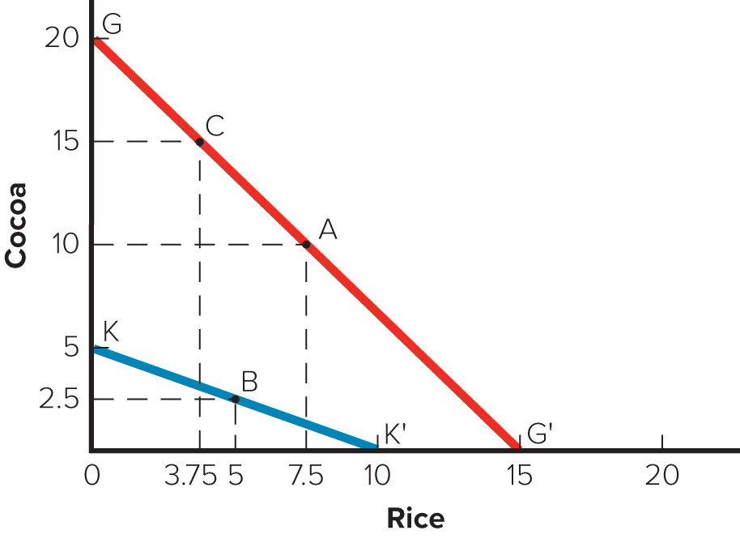
Figure 6.2 The Theory of Comparative Advantage
© McGraw Hill LLC
13

Slide 14
Comparative Advantage
2
The Gains from Trade
•
Potential world production is greater with unrestricted free
trade than with restricted trade.
•
The theory of comparative advantage suggests that trade
is a positive-sum game in which all countries that
participate realize economic gains.
© McGraw Hill LLC
14

Slide 15
Comparative Advantage
3
Qualifications and Assumptions
•
Simple world with two countries and two goods.
•
No transportation costs.
•
No differences in price of resources.
•
Resources can move freely.
•
Constant returns to scale.
•
Each country has a fixed stock of resources and free trade
does not change the efficiency with which a country uses
its resources.
•
No effects of trade on income distribution within a country.
© McGraw Hill LLC
15

Slide 16
Comparative Advantage
4
Extensions of the Ricardian Model
Immobile resources:
•
Resources do not always move easily from one economic
activity to another.
•
Political opposition to a free trade regime typically comes
from those whose jobs are most at risk.
© McGraw Hill LLC
16

Slide 17
Comparative Advantage
5
Extensions of the Ricardian Model
Diminishing returns:
•
Comparative advantage model assumes constant returns
to specialization.
•
More realistic to assume diminishing returns to
specialization.
•
Not all resources are the same quality.
•
Different goods use resources in different proportions.
© McGraw Hill LLC
17

Slide 18
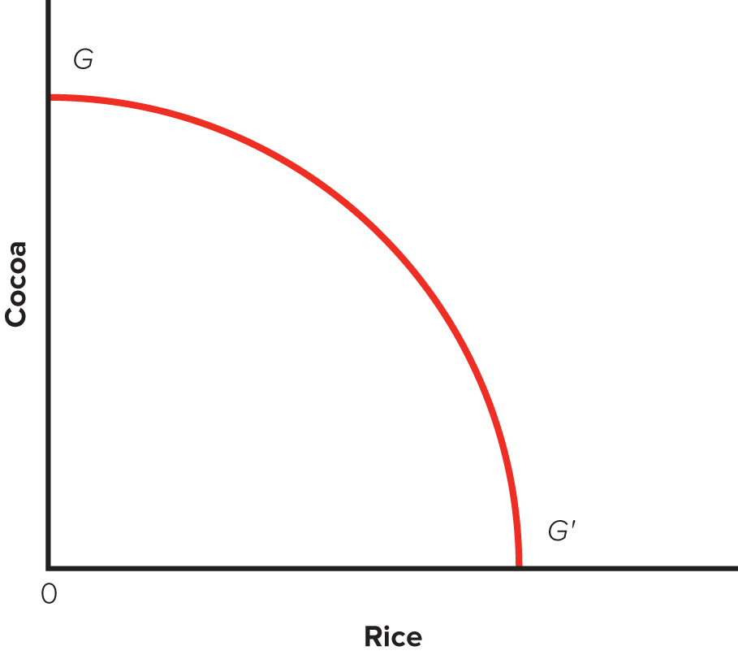
Figure 6.3 Ghana’s PPF under Diminishing Returns
© McGraw Hill LLC
18

Slide 19
Comparative Advantage
6
Extensions of the Ricardian Model
Dynamic effects and economic growth:
•
Free trade can result in two types of dynamic gains:
1.
Increase a country’s stock of resources as increased supplies of
labor and capital from abroad become available within the country.
2.
Increase the efficiency with which a country uses its resources.
•
Dynamic gains in both the stock of a country’s resources
and the efficiency with which resources are utilized will
cause a country’s PPF to shift outward.
© McGraw Hill LLC
19

Slide 20
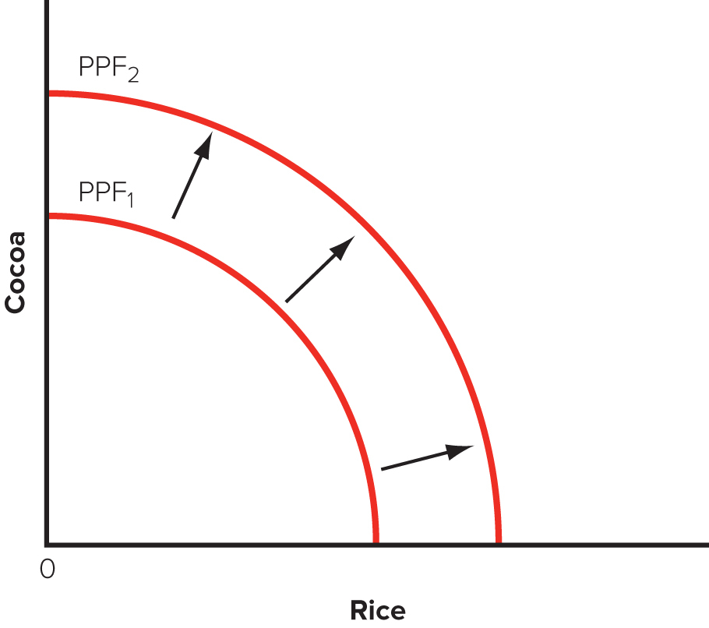
Figure 6.4 The Influence of Free Trade on the P
P
F
© McGraw Hill LLC
20

Slide 21
Comparative Advantage
7
Extensions of the Ricardian Model
Trade, jobs, and wages: The Samuelson critique.
•
Paul Samuelson asks: what happens when a rich country (United
States) enters into a free trade agreement with a poor country (China)
that rapidly improves its productivity after the introduction of a free
trade regime?
•
Lower prices may not make up for lower wages in the United States.
•
Concerned with offshoring service jobs.
•
Historically, free trade has benefited rich countries.
•
Introducing protectionist measures may be harmful to United States.
© McGraw Hill LLC
21

Slide 22
Comparative Advantage
8
Extensions of the Ricardian Model
Evidence for the link between trade and growth:
•
Countries that adopt a more open stance toward
international trade enjoy higher growth rates than those
that close their economies to trade.
•
Sachs and Warner created a measure of how “open” to
international trade an economy was.
•
Question about the impact of tariff barriers.
© McGraw Hill LLC
22

Slide 23
Heckscher–Ohlin Theory
1
Factor Endowments
Comparative advantage arises from differences in national
factor endowments.
•
Extent to which a country is endowed with resources such
as land, labor, and capital.
Countries will export goods that make intensive use of
factors that are locally abundant.
Countries will import goods that make intensive use of
factors that are locally scarce.
© McGraw Hill LLC
23

Slide 24
Heckscher–Ohlin Theory
2
The Leontief Paradox
•
Raised questions about the validity of the Heckscher–
Ohlin theory.
•
Found that U.S. exports were less capital intensive than
U.S. imports.
© McGraw Hill LLC
24

Slide 25
The Product Life-Cycle Theory
1
Raymond Vernon’s Product Life-Cycle Theory
For most of twentieth century, new products were developed
and first sold in the United States.
•
Due to the wealth and size of the U.S. market and cost-saving
process innovations.
Limited initial demand necessitates some exports early in
product life cycle.
Over time, demand grows in other countries, the product
becomes standardized, and price becomes the main
competitive weapon.
•
Other countries can now produce product at lower costs,
limiting the potential for U.S. exports.
© McGraw Hill LLC
25

Slide 26
The Product Life-Cycle Theory
2
Product Life-Cycle Theory in the Twenty-First Century
•
Historically, an accurate theory.
•
Now seems ethnocentric and increasingly dated.
© McGraw Hill LLC
26

Slide 27
New Trade Theory
1
Economies of Scale
Cost reductions associated with large-scale production.
Can have important implications for international trade.
•
Trade can increase the variety of goods available to
consumers and decrease the average cost of those
goods.
•
The global market may support only a small number of
enterprises for industries in which the output required to
attain economies of scale represents a significant
proportion of total world demand.
© McGraw Hill LLC
27

Slide 28
New Trade Theory
2
Increasing Product Variety and Reducing Costs
What would happen in a world without trade?
•
The variety of goods a country can produce and the scale
of production are limited by the size of the market.
•
Low volumes and higher costs.
What happens in a world with trade?
•
Individual national markets are combined into a larger
world market.
•
Each nation can increase the variety of goods and lower
the costs of those goods.
© McGraw Hill LLC
28

Slide 29
New Trade Theory
3
Economies of Scale, First-Mover Advantages, and the
Pattern of Trade
First-mover advantages:
•
Economic and strategic advantages accruing to early to
enter a market.
•
Can gain a scale-based cost advantage; later entrants find
it almost impossible to match.
© McGraw Hill LLC
29

Slide 30
New Trade Theory
4
Implications of New Trade Theory
Nations may benefit from trade even when they do not differ
in resource endowments or technology.
A country may predominate in the export of a good simply
because it was lucky enough to have one or more firms
among the first to produce that good.
•
May create a barrier to entry.
Useful in explaining trade patterns.
Argues for government intervention and strategic trade
policy.
© McGraw Hill LLC
30

Slide 31
National Competitive Advantage: Porter’s Diamond
1
Porter believed existing theories only told part of the story.
•
Wanted to explain why a nation achieves international
success in a particular industry.
•
Four broad attributes of a nation shape the environment in
which local firms compete:
1.
Factor endowments.
2.
Demand conditions.
3.
Related and supporting industries.
4.
Firm strategy, structure, and rivalry
© McGraw Hill LLC
31

Slide 32
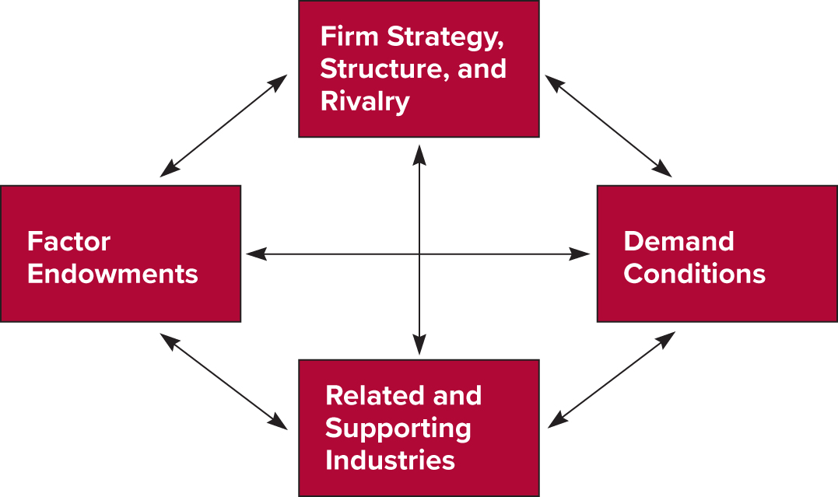
Figure 6.5
The Determinants of National Competitive
Advantage: Porter’s Diamond
Source: Michael E. Porter,
The Competitive Advantage of Nations
(New York: Free Press, 1990;
republished with a new introduction, 1998), p. 72.
© McGraw Hill LLC
32

Slide 33
National Competitive Advantage: Porter’s Diamond
2
Porter’s four attributes constitute a diamond.
Firms are most likely to succeed in industries or industry
segments where the diamond is most favorable.
•
The diamond is a mutually reinforcing system.
•
Two additional variables can influence the national
diamond:
1.
Chance.
2.
Government.
© McGraw Hill LLC
33

Slide 34
National Competitive Advantage: Porter’s Diamond
3
Factor Endowments
Basic factors:
•
Natural resources, climate, location, and demographic.
•
Can provide an initial advantage.
Advanced factors:
•
Communication infrastructure, sophisticated and skilled
labor, research facilities, and technological know-how.
•
Are a product of investment by individuals, companies,
and governments.
© McGraw Hill LLC
34

Slide 35
National Competitive Advantage: Porter’s Diamond
4
Demand Conditions
•
Firms gain competitive advantage if their domestic
consumers are sophisticated and demanding.
Related and Supporting Industries
•
Investments in advanced factors of production by related
and supporting industries can help the industry achieve a
strong competitive position internationally.
•
Successful industries within a country tend to be grouped
into clusters of related industries.
© McGraw Hill LLC
35

Slide 36
National Competitive Advantage: Porter’s Diamond
5
Firm Strategy, Structure, and Rivalry
•
Different nations are characterized by different
management ideologies, which may or may not help them
build national competitive advantage.
•
Strong association between vigorous domestic rivalry and
the creation and persistence of competitive advantage in
an industry.
© McGraw Hill LLC
36

Slide 37
National Competitive Advantage: Porter’s Diamond
6
Evaluating Porter’s Theory
Government can influence each component—either
positively or negatively.
•
Factor endowments can be affected by subsidies, policies
toward capital markets, policies toward education, and more.
•
Can shape domestic demand through local product standards
or with regulations.
•
Can influence firm rivalry through capital market regulation, tax
policy, and antitrust laws.
Porter’s theory has not been subjected to detailed empirical
testing.
© McGraw Hill LLC
37

Slide 38
360° View: Managerial Implications
Location, First-Mover Advantages, Government Policy,
Investments, and strategy
Location: from a profit perspective, firms should disperse
production to countries where they can be performed most
efficiently.
First-mover advantages: it pays to invest substantial financial
resources in building an early advantage.
Government policy: businesses can exert a strong influence
on government trade policy.
•
According to Porter, government should invest in
education, infrastructure, and basic research.
© McGraw Hill LLC
38

